Slide 1
Similarity Search Algorithms on Embeddings in Face Recognition
A Seminar on

Slide 2
By Apoorv Dixit
Roll Number - 31106
Under the guidance of
Prof. P. S. Vidap

Slide 3
Contents
Introduction
Motivation
Literature Survey
Challenges
Proposed Architecture
Feature Extraction
Nearest Neighbour Search
Methodology
Source Code Snippets
Result And Analysis
Conclusion
Future Scope
References

Slide 4
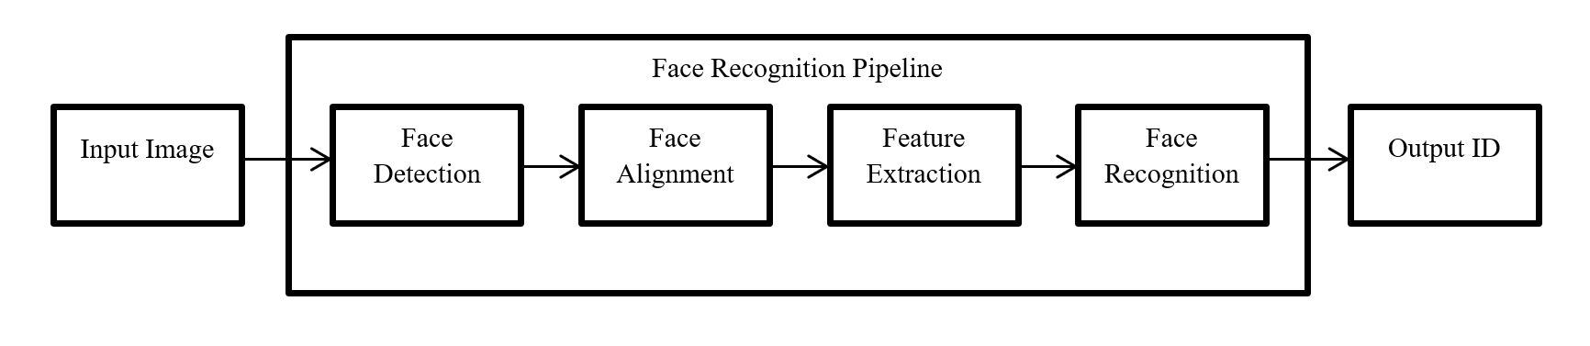
Introduction
Face Recognition is the task of identifying a person from either a digital image or a frame from a video.
It finds its application in a wide variety of fields like robotics, access controls in security systems, commercial identification, etc.
Face Recognition Pipelines are primarily broken down into:
Face Detection
Face Alignment
Feature Extraction
Face Recognition

Slide 5
Motivation
Face Recognition is a task that can be performed trivially by humans, but can prove to be a daunting challenge for machines.
Accuracy is not that big of a problem in Face Recognition Systems anymore.
However, making these Deep Learning Models more suited for real time tasks is still a mammoth task.
The memory footprint of these models is way too heavy to be used for real time systems.
Moreover deep learning pipelines are composed of multiple deep learning models.
This issue can be tackled in two ways:
Design a more light weight deep learning model for feature extraction.
Select a fast ANN for the final recognition subtask.

Slide 6
Literature Survey
ANN-Benchmarks: A Benchmarking Tool for Approximate Nearest Neighbor Algorithms [1]
a tool for evaluating the performance of different nearest neighbor algorithms on different standard data sets.
FaceNet: A Unified Embedding for Face Recognition and Clustering [2]
FaceNet proposes a deep learning model that aims to optimize the process of feature extraction itself.
Disentangled representation learning GAN for pose invariant face recognition [3]
The encoder decoder structure of this General Adversarial Network learns a generative pose invariant embedding of face images
It does so by leveraging face frontalization generation and taking multiple images as input.

Slide 7
Vggface2: A dataset for recognising faces across pose and age [4]
VGGFace2 is a face dataset contains 3.31 million images of 9131 subjects, with an average of 362.6 images for each subject.
Images have large variations in pose, age, illumination, ethnicity and even image noise.
DR-GAN [3] was trained on this dataset.
Visualizing data using t-SNE [5]
t-SNE is a technique that visualizes high-dimensional data by giving each data-point a location in a 2D or 3D map.
The technique is a variation of Stochastic Neighbor Embedding but is much easier to optimize.
It produces significantly better visualization for high dimensional data.
In this seminar we demonstrate clustering capabilities of the face embeddings used with t-SNE technique [5] .

Slide 8
Challenges
Proprietary Feature Extracting Models
Older ANNs are implemented in Python 2
Need better GPUs for generating a larger embedding dataset

Slide 9
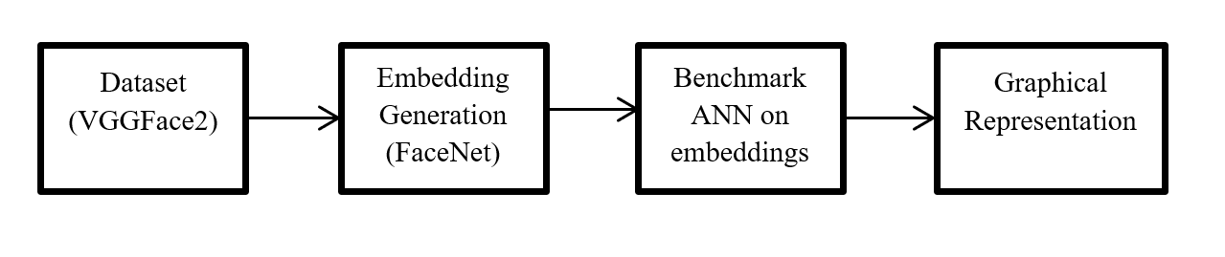
Proposed Architecture
In this seminar we are going to focus on two aspects of Face Recognition – Embeddings and ANNs.
I have generated embeddings of face images from a face dataset.
Then I have benchmarked some NNS libraries present in Python Language on the embeddings generated.
The benchmarked results have further been tabulated and graphical representation of the same is generated.

Slide 10
Feature Extraction
For Feature extraction, the deep learning model trains itself to extract features of a given dimension from millions of images.
The output of these models is a vector of a given dimension which encompasses the features of the face. These are called embeddings.
The embedding of the person in question is generated, which is then compared against the embeddings of the faces stored in the database.
Face Embeddings used in this Seminar:
FaceNet
DR-GAN

Slide 11
Nearest Neighbour Search
Nearest neighbor search (NNS) is the optimization problem of finding the point in a given set that is to a given point.
Approximate Nearest Neighbour Search (ANN) are the NNS which retrieves a good guess of the nearest neighbour which may or may not be the actual nearest neighbour.
ANN does so for improved speed and memory savings.
The recognition subtask involves comparing the embedding of the face obtained with that of faces stored in a database.
This subtask returns the ID of the person the face resembles the closest to, thereby recognizing the person.
The comparison is done by an ANN.

Slide 12
Implementation
Two databases of Face Embeddings have been prepared, one using FaceNet and the other using DR-GAN.
The Face Dataset used is VGGFace2[4].
TSNE Analysis has been done on both the databases to analyze how well the embeddings cluster.
Python libraries of various NNS have been benchmarked on the basis of queries executed versus Time.
This benchmarking has been done on the FaceNet embeddings.
Finally the results have been tabulated and represented in a graphical format.

Slide 13
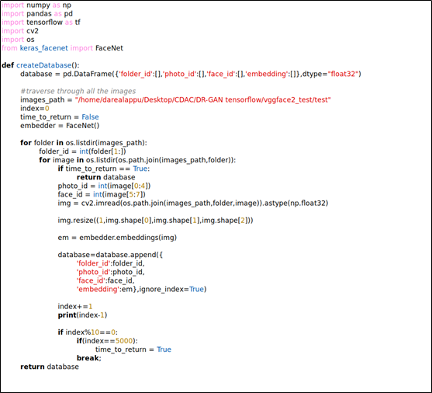
Source Code Snippets
Generating FaceNet Embeddings from VGGFace2 Face Dataset

Slide 14
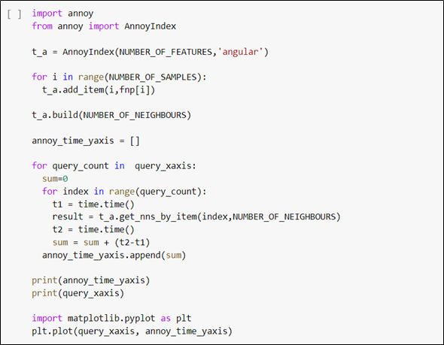
Benchmarking of an ANN that does not support batch processing

Slide 15
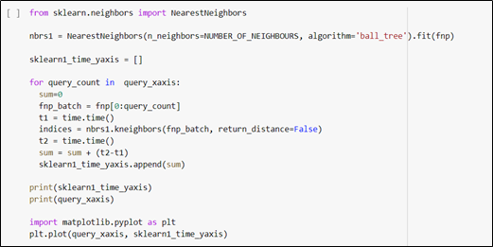
Benchmarking of an ANN that supports batch processing

Slide 16
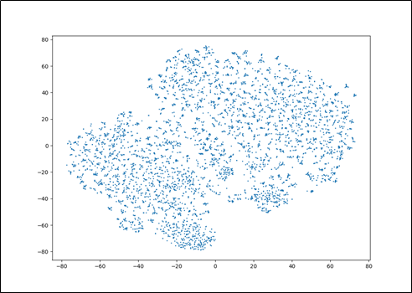
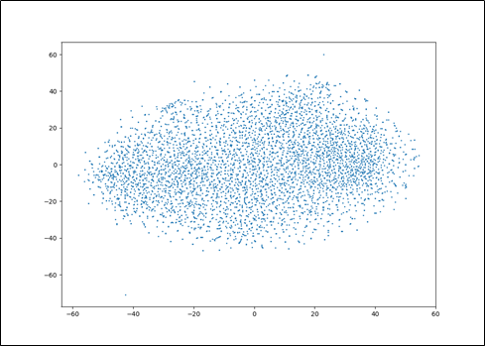
Result And Analysis
TSNE Analysis of FaceNet and DR-GAN Embeddings
Significant clustering takes place in FaceNet, which is not the case with DR-GAN.
TSNE Analysis on FaceNet Embeddings
TSNE Analysis on DR-GAN Embeddings

Slide 17
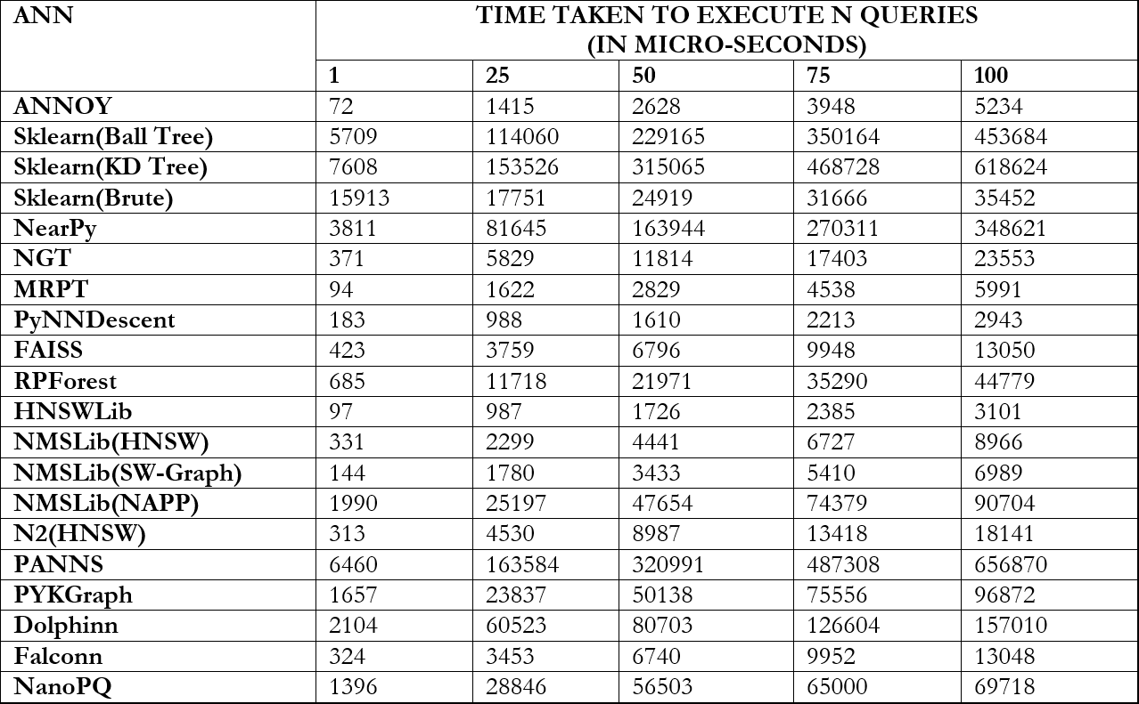
The ANN benchmarking has been tabulated in the following Table

Slide 18
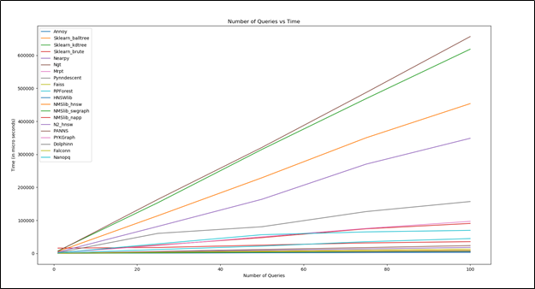
Graphical Representation
Number of Queries vs Time

Slide 19
Conclusion
This seminar provides an insight on generation of face embeddings and analysis of performance of various ANN Libraries.
The results generated establish that while ANNOY ANN is the fastest ANN for a single query, PyNNDescent delivers the fastest results for multiple queries, given that it can facilitate batch processing as well.
Some other fast ANNs are HNSWLib, NMSLib, MRPT and NGT.
The results generated will help developers choose a suitable ANN for their Face Recognition Pipeline.

Slide 20
Future Scope
Include more Deep Learning Models for Embedding Generators.
Include ANN algorithms written in Python2 by converting their code to Python3 and further optimize their performance with the new features of Python3.
A larger Embedding Dataset can be generated to capture the performance of ANN more accurately

Slide 21
References
Martin Aumüller, Erik Bernhardsson, and Alexander Faithfull. “ANN-benchmarks: Abenchmarking tool for approximate nearest neighbor algorithms”. In:International Conference on Similarity Search and Applications. Springer. 2017, pp. 34–49.
Florian Schroff, Dmitry Kalenichenko, and James Philbin. “Facenet: A unified embeddingfor face recognition and clustering”. In:Proceedings of the IEEE conference on computervision and pattern recognition. 2015, pp. 815–823.
Luan Tran, Xi Yin, and Xiaoming Liu. “Disentangled representation learning gan forpose-invariant face recognition”. In:Proceedings of the IEEE conference on computervision and pattern recognition. 2017, pp. 1415–1424.
Qiong Cao et al. “Vggface2: A dataset for recognising faces across pose and age”. In:2018 13th IEEE International Conference on Automatic Face&Gesture Recognition (FG2018). IEEE. 2018, pp. 67–74.
Laurens van der Maaten and Geoffrey Hinton. “Visualizing data using t-SNE”. In:Journalof machine learning research9.Nov (2008), pp. 2579–2605.

